Slide 1

Business Administration
SOFTWARE
ALA-TOO INTERNATIONAL UNIVERSITY
Spring Semester 2025-2026

Slide 2

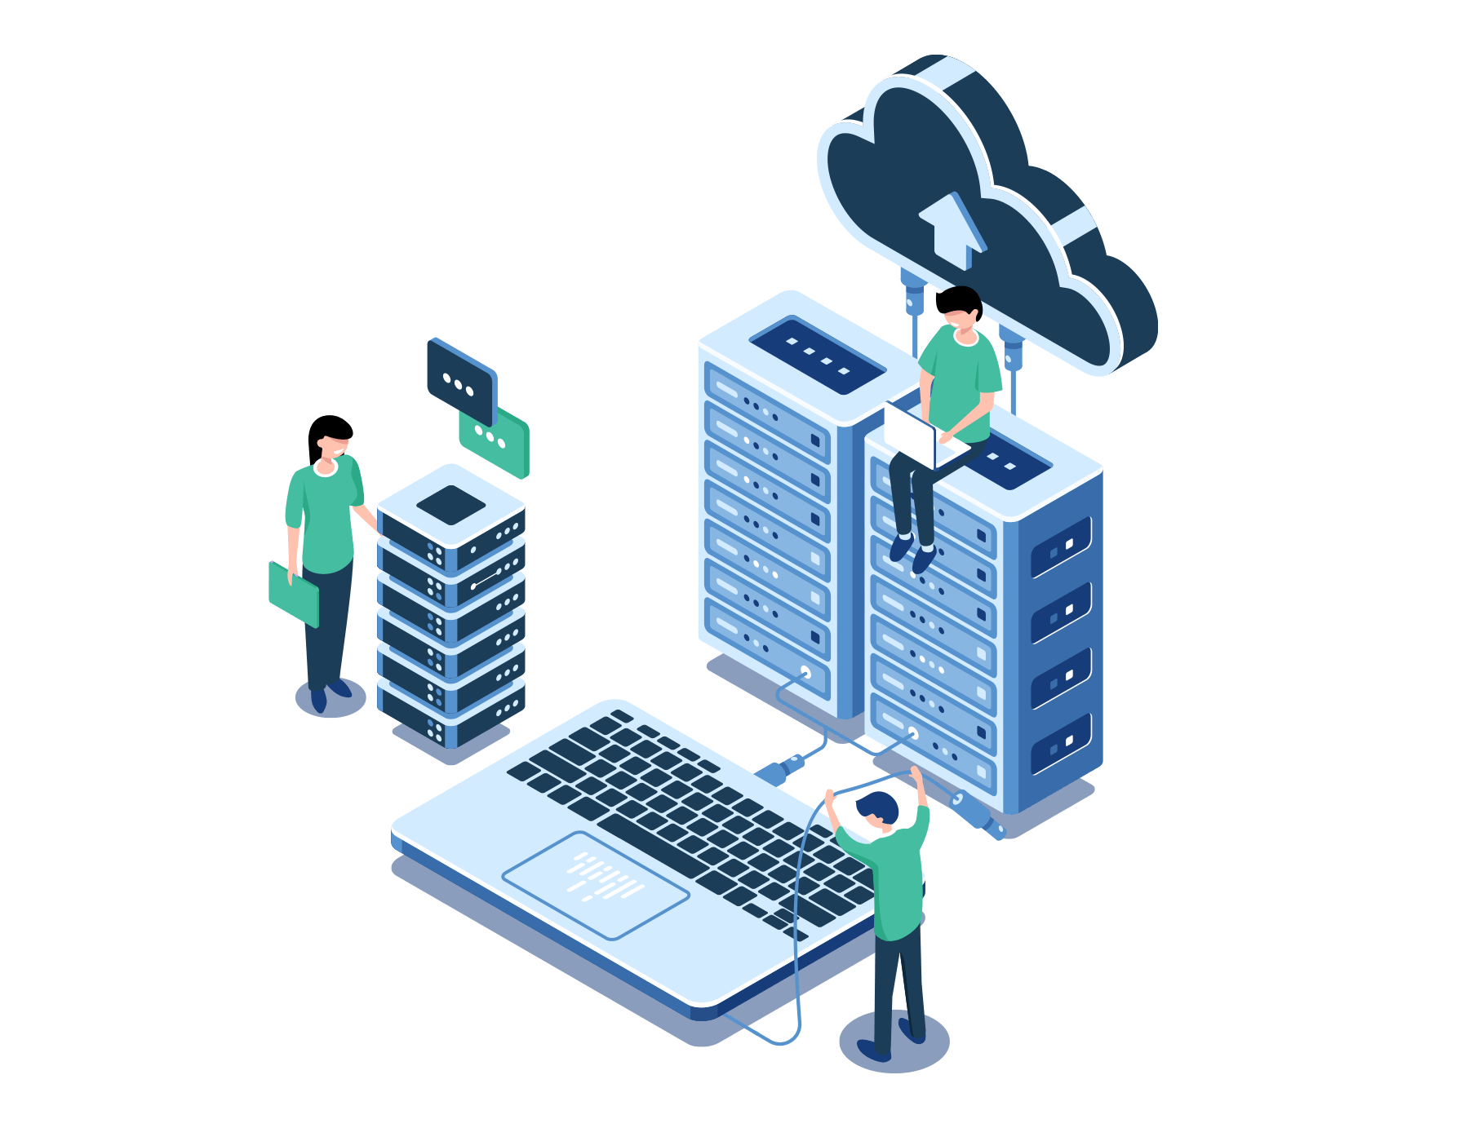




Lecturer
Nurbekov Mirlan
Office: H 207
Monday–Friday, 08:00–17:00
mirlan.nurbekov@alatoo.edu.kg

Slide 3
***
Every company is a software company, whether it knows it or not.
— Satya Nadella

Slide 4

COURSE INTRODUCTION WHAT THIS SUBJECT IS
Practical + conceptual
Designed for IT students
Focus on how companies really work

Slide 5

IT IS NO LONGER ISOLATED CROSS FUNCTIONAL WORK
Technical decisions affect business outcomes
Developers work with managers Engineers interact with finance and HR

Slide 6
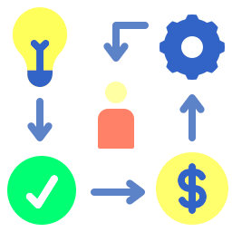
KEY CONCEPTS WHAT YOU WILL LEARN
BUSINESS PROCESSES
Understanding how finance, sales, HR, and operations function inside organizations.
DIGITAL WORKFLOWS
Learning how these processes are executed, automated, and monitored using software systems.
SOFTWARE CATEGORIES
Identifying the purpose and role of major business software platforms such as ERP, CRM, accounting, project management, and analytics tools.
SYSTEM INTEGRATION
Understanding how different systems share data, depend on each other, and form a unified digital environment.

Slide 7

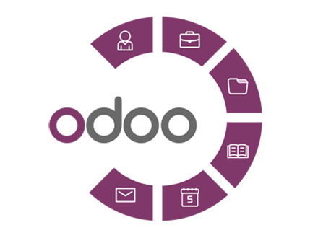
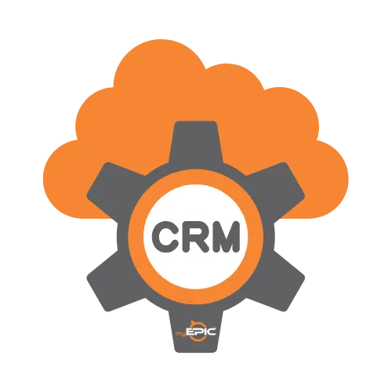

TOOLS OVERVIEW SOFTWARE YOU WILL SEE
EXCEL / GOOGLE SHEETS
Used as foundational tools for working with business data, reports, and simple analytics
ERP PLATFORMS
Introduced to demonstrate how organizations integrate finance, HR, inventory, and operations within a single system.
CRM SYSTEMS
Used to explain how companies track customers, sales pipelines, and customer-related data.
DASHBOARDS
Used to illustrate how business data is transformed into visual reports that support managerial decisions.

Slide 8

COURSE STRUCTURE SEMESTER FLOW
Foundations → Systems → Integration → Assessment

Slide 9
COURSE STRUCTURE SEMESTER FLOW
FOUNDATIONS
The core concepts such as business processes, digital workflows, and the role of software in organizations
SYSTEMS
The course then focuses on major categories of business administration software, including ERP, CRM, accounting, project management, and analytics tools
INTEGRATION
In the final stage, you will need to analyze how different systems exchange data and form a unified digital business environment
ASSESSMENTS
Learning is evaluated through an online midterm and a final examination, using scenario-based questions

Slide 10

HOW YOU ARE GRADED ASSESSMENT METHODS
Final Grade = Midterm Assessment (40%) + Final Assessment (60%)
– – –
Midterm Assessment = accumulated score (attendance + test)
Final Assessment = exam

Slide 11
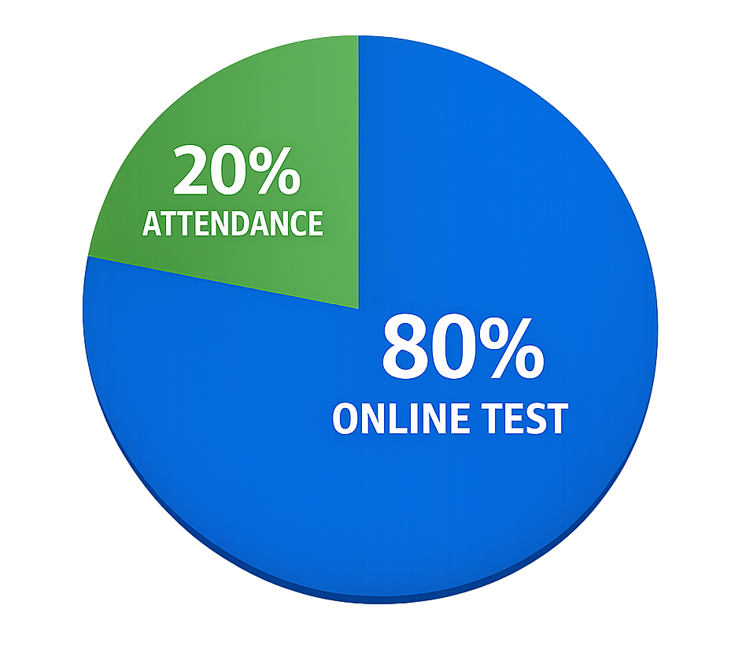
MIDTERM ASSESSMENT BREAKDOWN 100 POINTS
20% - attendance
80% - online test (openbook)

Slide 12

FINAL ASSESSMENT 100 POINTS
100% - online exam (openbook)

Slide 13

STUDENT RESPONSIBILITY WHAT IS EXPECTED FROM YOU
ATTENDANCE
You are expected to attend classes consistently, as course concepts build progressively

Slide 14

STUDENT RESPONSIBILITY WHAT IS EXPECTED FROM YOU
ACTIVE PARTICIPATION
Engagement in discussions and in-class activities is essential for understanding real-world business software scenarios.

Slide 15

STUDENT RESPONSIBILITY WHAT IS EXPECTED FROM YOU
CONCEPTUAL UNDERSTANDING
The course emphasizes understanding how systems work and interact, rather than memorizing definitions or tools.

Slide 16

STUDENT RESPONSIBILITY WHAT IS EXPECTED FROM YOU
PROFESSIONAL BEHAVIOR
You are expected to communicate respectfully, meet deadlines, and follow academic integrity standards.

Slide 17
PRACTICAL VALUE HOW THIS HELPS YOUR CAREER
INDUSTRY READINESS
You gain exposure to software systems commonly used in real organizations, reducing the learning curve during internships.
INTERVIEW CONFIDENCE
Understanding how business software works allows students to answer scenario-based interview questions more effectively.
SYSTEM LEVEL UNDERSTANDING
The course develops the ability to see organizations as integrated digital systems rather than isolated applications.
BUSINESS AWARENESS
Students learn how technical systems support business decisions, operations, and management goals.

Slide 18
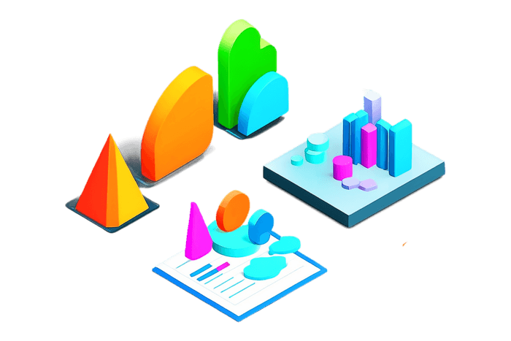
THE SOFTWARE RUNS THE WORLD INDUSTRY REALITY CHECK
Modern businesses operate through software
Decisions, money, customers, employees are all DIGITAL
IT specialists work inside business systems, not outside them

Slide 19

TODAY’S INDUSTRY REALITY ENTERPRISE RESOURCE PLANNING
ERP

Slide 20

TODAY’S INDUSTRY REALITY ENTERPRISE RESOURCE PLANNING
Enterprise Resource Planning (ERP) systems are integrated software platforms designed to manage and coordinate all major business processes within a single organization. Instead of using separate systems for finance, human resources, inventory, and operations, an ERP system centralizes data and workflows into one unified environment.

Slide 21

TODAY’S INDUSTRY REALITY ENTERPRISE RESOURCE PLANNING
ERP systems provide a single source of truth, meaning all departments work with the same data in real time. This reduces inconsistencies, improves coordination between teams, and enables management to make informed decisions based on accurate, up-to-date information.

Slide 22

TODAY’S INDUSTRY REALITY CUSTOMER RELATIONSHIP MANAGEMENT
CRM

Slide 23
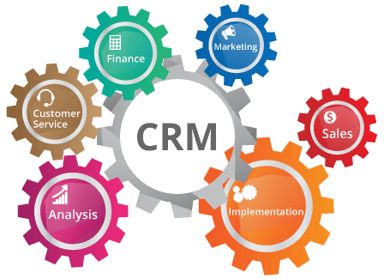
TODAY’S INDUSTRY REALITY CUSTOMER RELATIONSHIP MANAGEMENT
Customer Relationship Management (CRM) systems are software platforms used to track, organize, and manage all interactions between a company and its customers. A CRM system stores customer information, communication history, sales activities, and transaction data in one centralized system. These systems allow companies to treat customers not as isolated contacts, but as long-term business assets whose behavior, preferences, and value can be analyzed and managed over time.

Slide 24
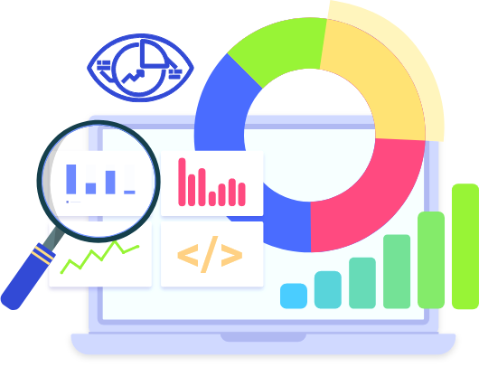
TODAY’S INDUSTRY REALITY ANALYTICS TOOLS
Analytics tools are software systems that collect, process, and visualize business data to support managerial and operational decision-making. Instead of relying on intuition or manual reports, organizations use analytics tools to transform raw data into meaningful insights.These tools aggregate data from multiple systems such as ERP, CRM,accounting software and present it in the form of dashboards, reports, and performance indicators.

Slide 25


TODAY’S INDUSTRY REALITY IT TEAMS
Modern IT teams do not work with a single system in isolation. In real organizations, IT specialists are expected to understand how multiple business software systems interact and how changes in one system affect others. ERP, CRM, accounting, project management, and analytics tools form a connected ecosystem. Effective IT work requires awareness of this ecosystem rather than deep focus on only one application.

Slide 26
BIG PICTURE VIEW HOW COMPANIES ACTUALLY OPERATE
MONEY FLOWS DIGITALLY
Financial transactions, invoices, salaries, and budgets are recorded and processed through accounting and ERP systems, enabling real-time financial control and reporting.
CUSTOMERS LIVE IN DATABASES
Customer information, interactions, purchases, and support history are stored in CRM systems, allowing organizations to manage relationships and analyze customer behavior
EMPLOYEES ARE MANAGED BY SYSTEMS
HR information systems track employee records, roles, access rights, attendance, and payroll, supporting structured workforce management.
DECISIONS RELY ON DASHBOARDS
Managers use dashboards and analytical reports to monitor performance, identify trends, and make data-driven decisions based on aggregated system data

Slide 27
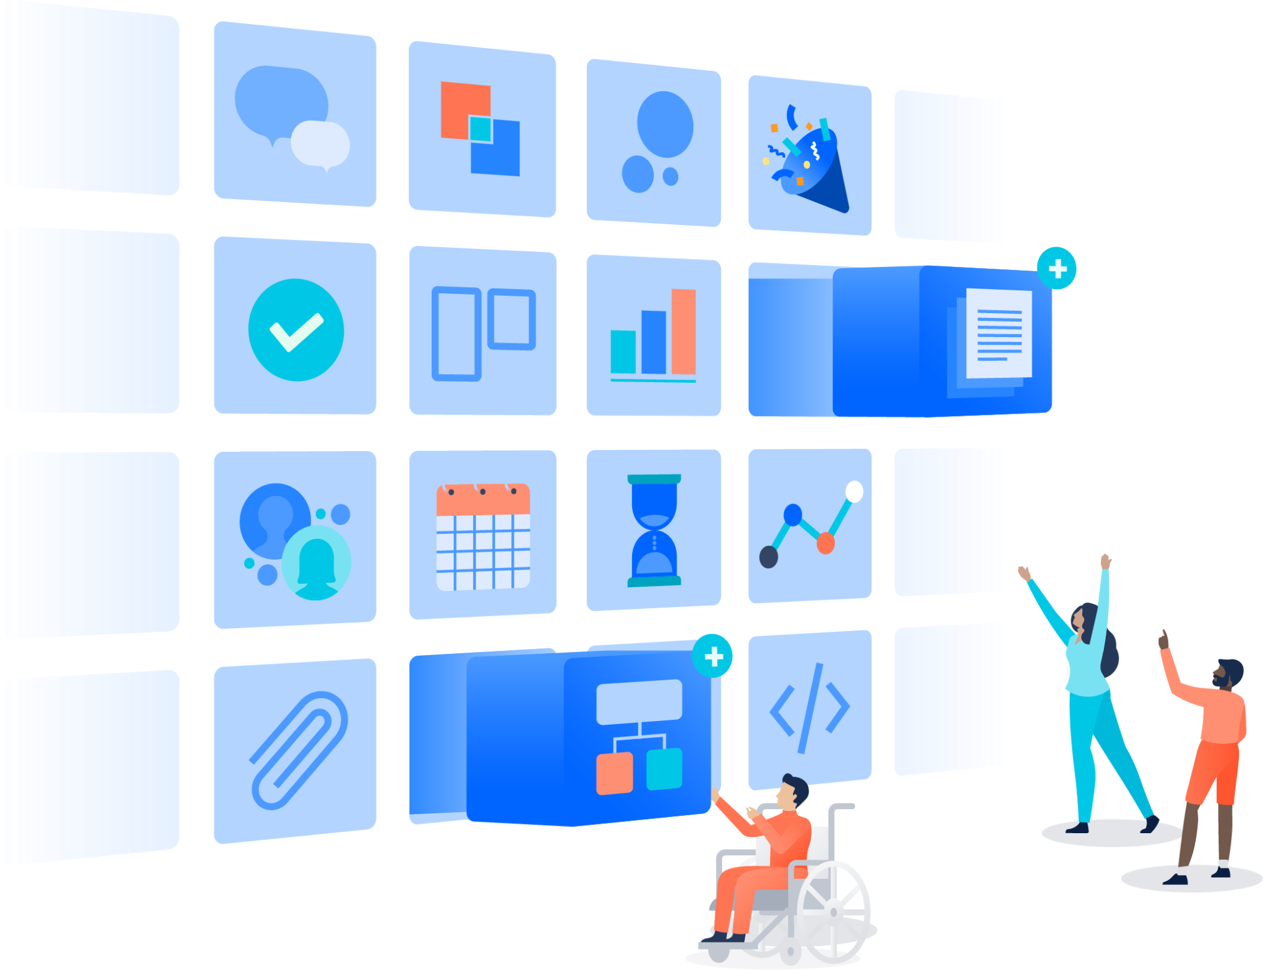
SOFTWARE CATEGORIES OVERVIEW ECOSYSTEM MAP
Accounting systems
ERP platforms
CRM systems
Project management tools
Analytics and reporting tools

Slide 28


ACCOUNTING SOFTWARE MONEY AS DATA
Tracks income and expenses
Generates financial reports
Used by managers, not just accountants

Slide 29
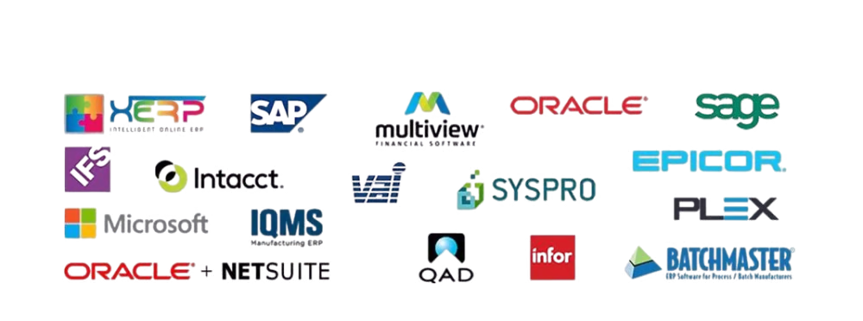
ERP SYSTEMS DIGITAL BACKBONE
Integrates all departments
Single source of truth
Finance, HR, inventory, operations
Core system of medium & large companies

Slide 30
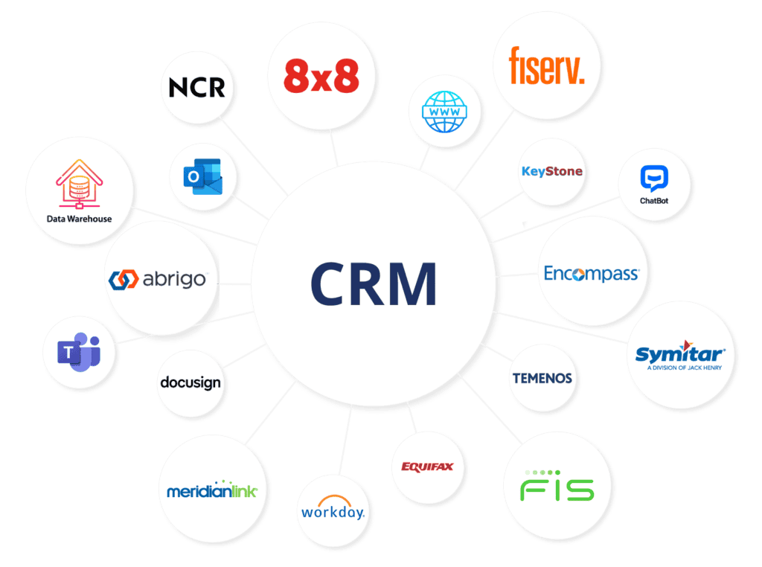
CUSTOMER MANAGEMENT CRM SYSTEMS
Tracks leads and customers Sales pipelines and funnels
Customer data = business value

Slide 31
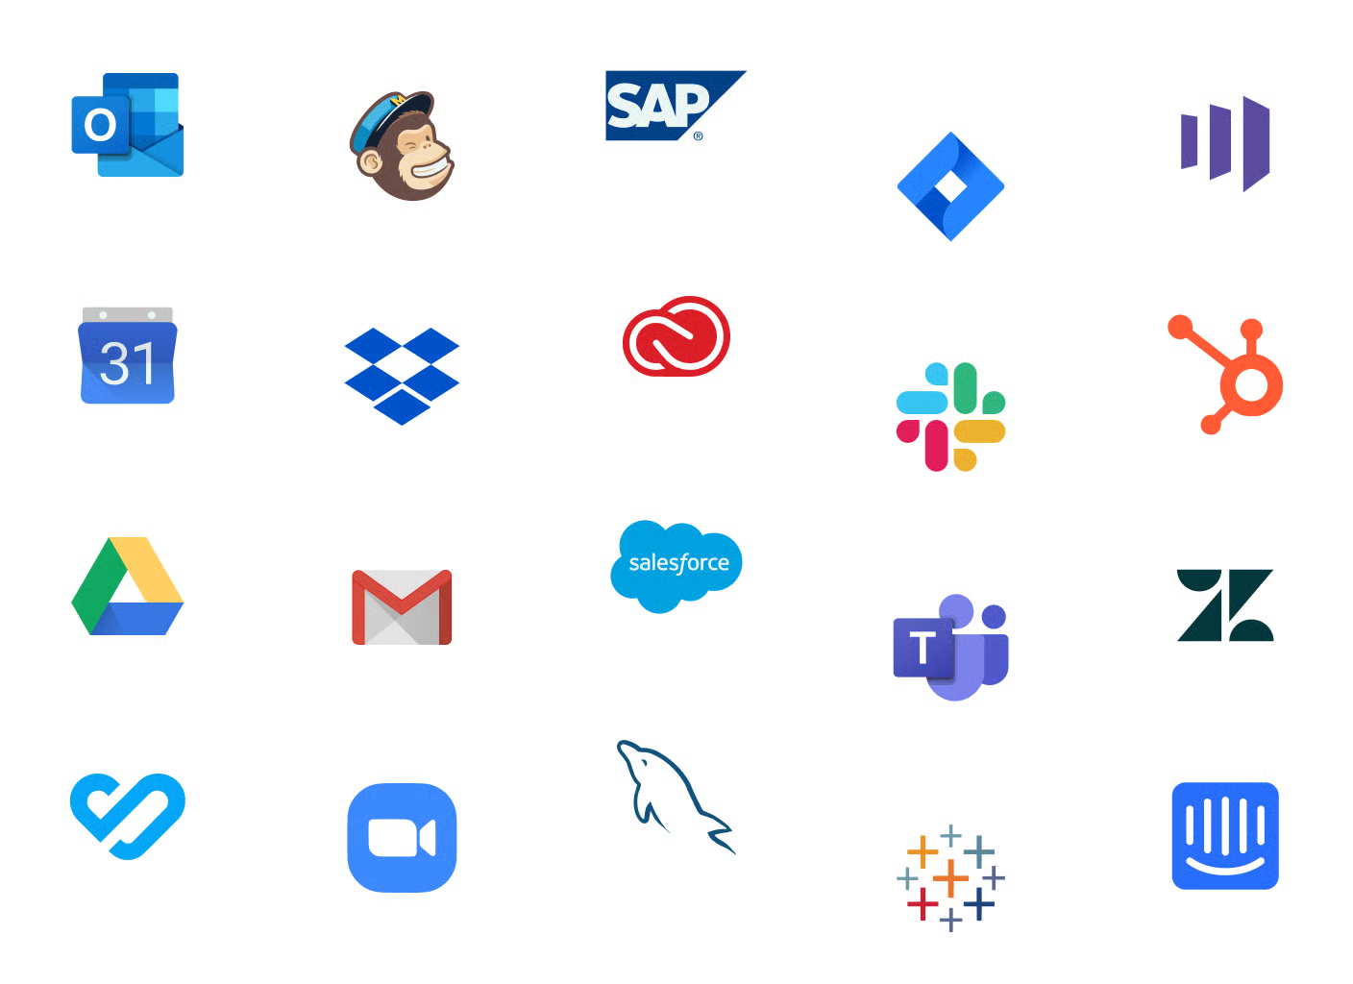
PROJECT MANAGEMENT TOOLS WORK ORGANIZATION
Tasks, roles, deadlines Agile vs traditional planning
Used in IT and business teams

Slide 32
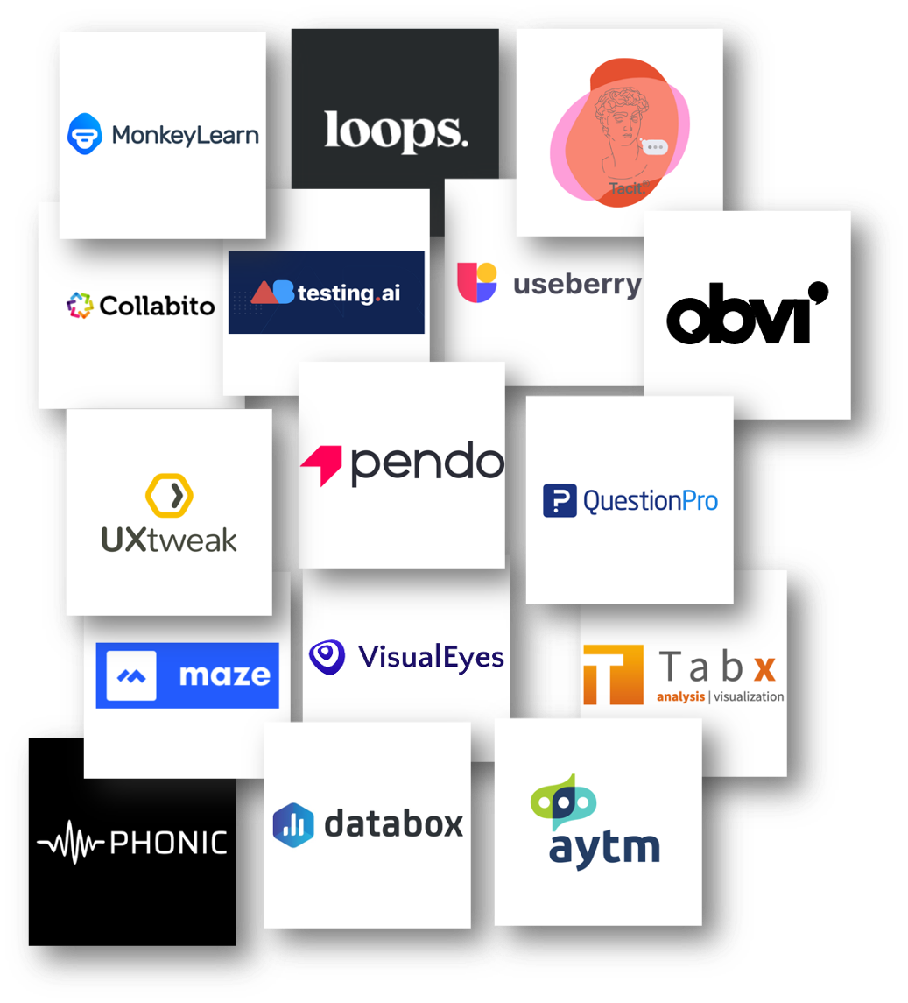
ANALYTICS AND DASHBOARDS DECISION SUPPORT
KPIs and metrics
Data-driven decisions
Management dashboards

Slide 33
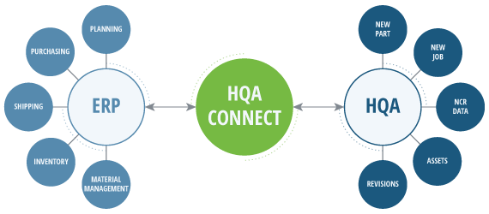
HOW SYSTEMS CONNECT INTEGRATION CONCEPT
ERP feeds analytics CRM feeds sales data
Accounting feeds reports
Integration is critical

Slide 34
A DAY IN A DIGITAL COMPANY REALISTIC SCENARIO
Customer places order
Inventory updates
Invoice generated
Manager sees dashboard

Slide 35
FUTURE RESPONSIBILITY YOUR ROLE AS AN IT SPECIALIST
CONFIGURE SYSTEMS
IT specialists customize and configure business software to align with organizational processes and technical requirements. This includes setting up system modules, defining user roles and access rights, configuring workflows, integrating third-party services, and adapting data structures to business needs. For example, in an ERP system such as Odoo or SAP, IT specialists configure accounting rules, inventory logic, approval flows, and system integrations to ensure that daily operations reflect real business processes rather than default system behavior

Slide 36
FUTURE RESPONSIBILITY YOUR ROLE AS AN IT SPECIALIST
SUPPORT WORKFLOWS
You ensure that digital workflows operate efficiently across departments and systems. This involves monitoring system performance, resolving process bottlenecks, maintaining integrations between platforms (such as ERP and CRM), and ensuring data consistency. For example, when a sales order is created in a CRM system, IT specialists ensure that it correctly triggers inventory updates, invoicing, and reporting in connected ERP and accounting systems without manual intervention or data loss.

Slide 37
FUTURE RESPONSIBILITY YOUR ROLE AS AN IT SPECIALIST
INTERPRET DATA
As IT professionals you will need to analyze and interpret system generated data to support business understanding and decision-making. This includes working with reports, dashboards, logs, and metrics produced by ERP, CRM, and analytics platforms. For instance, IT specialists may help management understand sales trends, operational inefficiencies, or system performance issues by explaining dashboard indicators in tools like Power BI and validating that the underlying data sources and calculations are technically correct.

Slide 38
FUTURE RESPONSIBILITY YOUR ROLE AS AN IT SPECIALIST
COMMUNICATE WITH STAKEHOLDERS
IT specialists translate technical system behavior and data into clear, actionable information for managers and non-technical stakeholders. This requires explaining system limitations, data accuracy, integration dependencies, and the impact of technical changes on business operations. For example, when a system update affects reporting or workflows, IT specialists communicate the implications, risks, and expected outcomes to department heads in business-oriented language rather than technical terminology.

Slide 39
WHAT IF ? ERP IS MISCONFIGURED
Imagine an ERP system is deployed to manage inventory, purchasing, and finance, but the system is configured incorrectly. Stock quantities are calculated using wrong rules, supplier lead times are inaccurate, and approval workflows do not match real operations. The company believes it has inventory available, but in reality warehouses are either overstocked or empty.

Slide 40
REAL WORLD CONSEQUENCE ERP FAILURE
In the Target Canada expansion, ERP and supply chain system misconfiguration caused severe inventory errors. Stores received incorrect products, shelves were empty while warehouses were full, and financial data did not reflect reality. The system failure contributed to losses of billions of dollars and ultimately led to the shutdown of all Target operations in Canada for several days.

Slide 41
WHAT IF ? DATA IN CRM IS WRONG
Imagine a CRM system where customer records are duplicated, outdated, or incomplete. Sales teams contact the same customer multiple times, marketing campaigns target incorrect segments, and customer history is unreliable. Management dashboards show strong customer growth, but the data behind it is flawed.

Slide 42
REAL WORLD CONSEQUENCE CRM DATA FAILURE
Many large organizations using CRM platforms like Salesforce report that poor data quality leads to incorrect analytics and failed campaigns. Duplicate records and inconsistent customer data result in wasted marketing budgets, inaccurate forecasts, and loss of customer trust. In practice, bad CRM data often leads to decisions that look correct on paper but fail in the real market.

Slide 43
WHAT IF ? DASHBOARDS ARE WRONG
Imagine management relies on dashboards to make decisions, but the metrics are calculated incorrectly or based on incomplete data. KPIs look positive, trends appear stable, and risks are hidden. Decisions are made confidently, but they are based on misleading information.

Slide 44
REAL WORLD CONSEQUENCE DASHBOARDS ARE WRONG
Organizations have repeatedly faced losses due to incorrect dashboards and misinterpreted analytics. Errors in data pipelines, wrong assumptions in calculations, or missing data sources have caused companies to underestimate risks, overestimate performance, and make costly strategic decisions. When dashboards are wrong, decisions fail quietly until the damage is already done.

Slide 45

QUESTIONS AND DISCUSSION OPEN FLOOR

Slide 46
NEXT WEEK PREVIEW WHAT’S COMING
Business processes
Digital workflows
Mapping software to operations

